Slide 1


FINAL PROJECT REPORT
TikTok Data Analysis: Travel & Visa Content Performance - Final Project Report
A comprehensive data analysis approach to predicting content engagement through exploratory analysis, feature engineering, and classification modeling
COURSE: DATA ANALYSIS FOR AI APPLICATIONS
FACULTY OF COMPUTER SCIENCE TUC,CHEMNITZ
NAME: RICHARD DANQUAH
MATRICULATION NUMBER: 909921
DATE: 13TH FEBRUARY, 2025
DATA ANALYSIS IN AI

Slide 2

Research Overview & Objectives
This project applies machine learning techniques to predict the performance of TikTok content within the travel and visa niche. Our comprehensive approach aims to uncover the underlying factors contributing to content success on the platform.
Primary Objective
To develop a robust classification model capable of predicting whether TikTok content will achieve High, Medium, or Low engagement levels.
Secondary Objectives
Identify key features and content elements that significantly drive viewer engagement.
Understand prevailing content patterns and strategies employed by successful creators in this niche.
Provide actionable insights and data-driven recommendations for creators to optimize their content for maximum interaction.
Dataset & Methodology
Our analysis leverages a dataset of over 500 videos from 25 diverse creators, collected between October 2025 and January 2026. This dataset includes 24 distinct features, covering aspects such as hook styles, video duration, content format, and various engagement metrics. The methodology encompasses exploratory data analysis, meticulous feature engineering, handling of class imbalance, and the implementation of multi-class classification modeling.

Slide 3
Dataset Description & Structure
Data Sources & Collection
500+
24
Dataset contains 500+ TikTok videos from the travel and visa niche, collected via Apify TikTok Scraper API. Data spans October 2025 to January 2026, covering 25 content creators.
Total videos analyzed
Features per observation
Key Variables (24 features):
3
Content attributes: hook_style, content_format, video_duration_seconds, trending_sound_used
Temporal features: date_posted, post_time_hour_24h, day_of_week
Engagement metrics: views, likes, comments, shares, saves_or_favorites, engagement_rate
Performance indicators: followers_gained, watch_time_percentage, avg_watch_time_seconds
Target variable: performance_label (High/Medium/Low based on engagement_rate thresholds)
Performance classes (High/Medium/Low)

Slide 4
Milestones Completed
Data Collection & Preparation
Exploratory Data Analysis
Scraped 500+ videos via API, cleaned data, handled missing values, created derived features
Analyzed distributions, correlations, engagement patterns across hook types, duration, and content categories
Feature Engineering
Model Development
Created temporal features, encoded categorical variables, normalized numerical features, addressed class imbalance
Trained classification models, evaluated performance, interpreted results, generated actionable insights

Slide 5

Exploratory Data Analysis - Key Findings
Univariate Analysis
Categorical Analysis
Examined distributions of engagement metrics, video duration, posting patterns
Compared performance across hook_style, content_format, niche_category
Temporal Patterns
Bivariate Analysis
Explored relationships between features and engagement_rate
Analyzed posting time, day of week effects on engagement
Our exploratory analysis revealed significant patterns in content performance. Tutorial hooks and question-based openings consistently outperformed dramatic hooks. Videos between 30-45 seconds achieved optimal engagement. Visa application content showed highest engagement rates (7.2% avg), followed by travel hacks (6.4%). Temporal analysis showed posting time and day of week had moderate influence on performance.

Slide 6
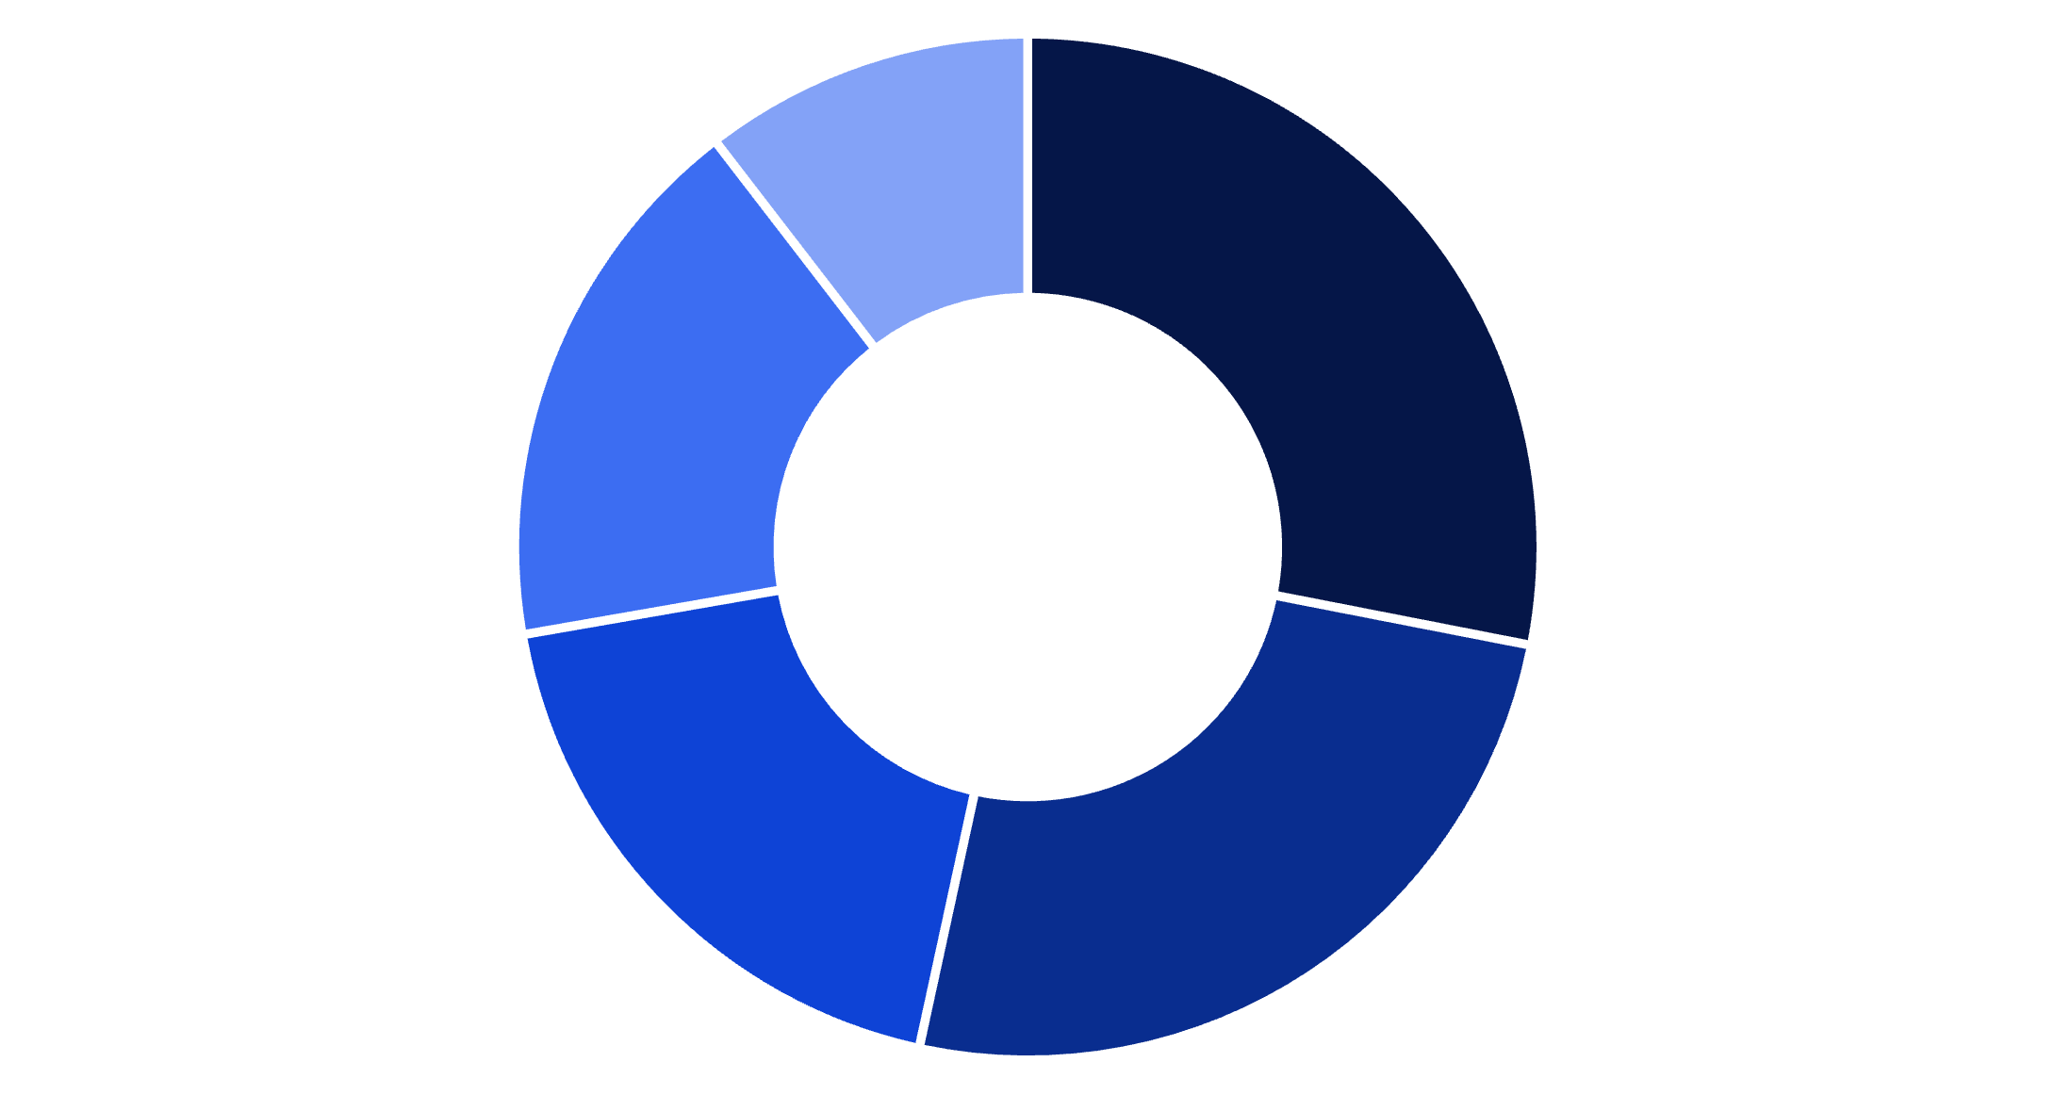
Content Hook Analysis: Distribution & Effectiveness
Hook Strategy Distribution
Question-based hooks dominate the travel/visa niche (28.2%), often opening with viewer queries like "How to get a visa in 3 days?" Tutorial hooks follow closely (25.4%), reflecting the educational nature of this content vertical.
Statistical hooks (18.9%) typically feature compelling numbers about visa approval rates or cost savings. Story-based openings (17.3%) leverage personal travel experiences to build connection.
Question
Tutorial
Statistic
Story
Dramatic

Slide 7
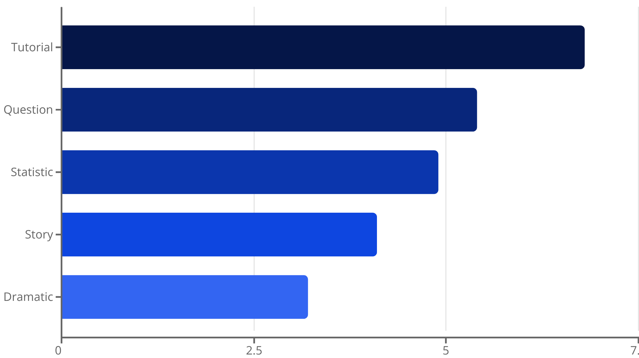
Engagement Rate by Hook Type
Key Findings
Tutorial hooks generated the highest average engagement rate at 6.8%, significantly outperforming other hook types. This suggests audiences in the travel/visa niche prioritize actionable, educational content over entertainment.
Question hooks ranked second (5.4% engagement), effectively driving curiosity and comment interaction. Surprisingly, dramatic hooks underperformed (3.2%), indicating this audience values practical information over sensationalism.

Slide 8
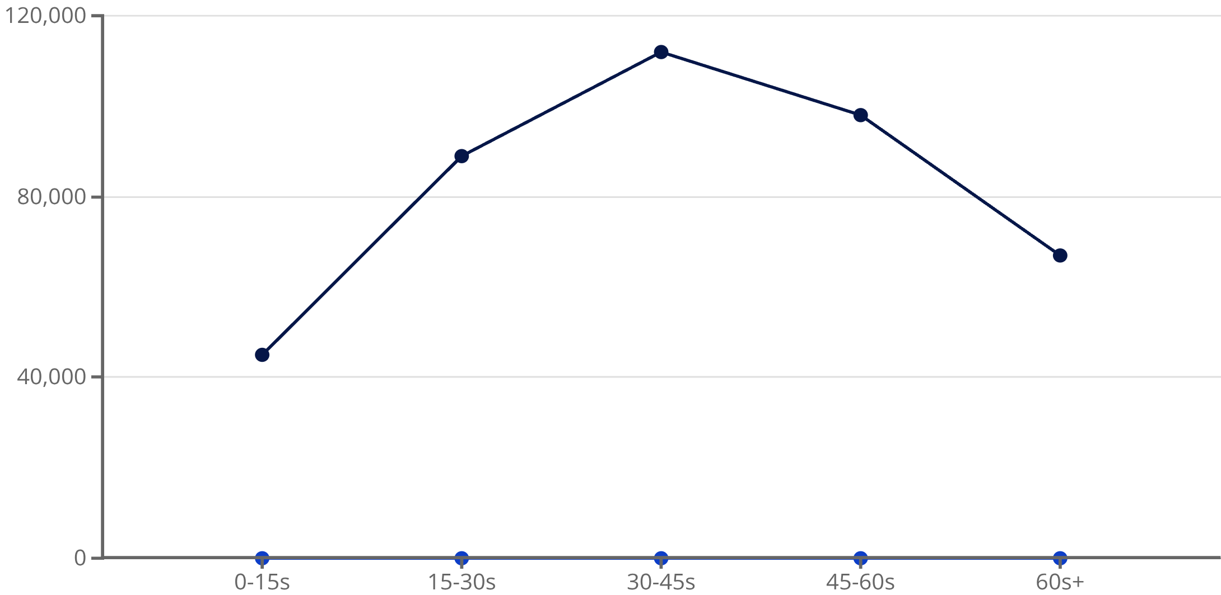
Video Duration vs. Engagement Performance
Optimal Video Length Insights
Videos between 30-45 seconds achieved peak performance, averaging 112K views and 7.1% engagement rate. This duration provides enough time to deliver valuable visa/travel information while maintaining viewer attention.
Very short videos (under 15 seconds) underperformed, likely insufficient for explaining complex visa processes. Videos exceeding 60 seconds showed declining metrics, suggesting audience fatigue in this information-dense niche.
Avg Views
Avg Engagement Rate (%)

Slide 9




Performance Classification - Target Variable Definition
High Performance
Medium Performance
Low Performance
Class Distribution
Engagement rate ≥ 6.0%. Represents top-performing content with strong audience interaction (35% of dataset)
Engagement rate 4.5% - 5.9%. Solid performance with moderate audience engagement (52% of dataset)
Engagement rate < 4.5%. Below-average performance requiring optimization (13% of dataset)
Imbalanced dataset with Medium class majority. Applied SMOTE and class weighting to address imbalance during modeling

Slide 10
Project Organization & Documentation
Project Organization & Documentation
This project follows a structured data analysis workflow with clear documentation at each stage. All code is organized in Jupyter notebooks with markdown explanations. The GitHub repository includes data files, preprocessing scripts, EDA notebooks, modeling code, and this final report.
Documentation Structure:
README.md: Project overview, setup instructions, dataset description
/data: Raw and processed CSV files
/presentation: presentation
/finalreport: Final presentation and technical documentation
Impact Summary
4
500+
24
Jupyter notebooks
Lines of Python code
Features engineered
documenting workflow
documented
and analyzed

Slide 11
Modeling Approach - Feature & Target Definition
Feature Engineering Process: We transformed the raw dataset into model-ready features through several steps:
Categorical Encoding
Numerical Features
One-hot encoding for hook_style (5 categories), content_format (3 types), niche_category (4 categories)
Binary encoding for trending_sound_used
Ordinal encoding for day_of_week
Standardized video_duration_seconds, post_time_hour_24h
Log transformation for highly skewed metrics (views, likes, comments)
Created engagement_rate = (likes + comments + shares) / views × 100
Temporal Features
Target Variable
Extracted hour_of_day, is_weekend from posting timestamps
Created time_bins (morning, afternoon, evening, night)
performance_label: 3-class classification (High/Medium/Low)
Based on engagement_rate thresholds: High ≥6.0%, Medium 4.5-5.9%, Low <4.5%
Original distribution: 35% High, 52% Medium, 13% Low
Final feature set: 18 engineered features ready for model training

Slide 12
Model Training & Evaluation
Classification Models Tested
78.3%
We evaluated multiple algorithms for multi-class classification:
Random Forest Classifier
Random Forest
Ensemble method with 100 decision trees
Handles non-linear relationships well
Provides feature importance rankings
Best overall accuracy
Gradient Boosting (XGBoost)
0.76
Sequential ensemble learning
Strong performance on imbalanced data
Hyperparameter tuning via GridSearchCV
XGBoost
Logistic Regression (Baseline)
Best F1-score
Simple linear model for comparison
Fast training, interpretable coefficients
5
Training Configuration:
5-fold CV
Train/test split: 80/20
Cross-validation: 5-fold stratified CV
Evaluation metrics: Accuracy, Precision, Recall, F1-score, ROC-AUC
Robust validation approach

Slide 13
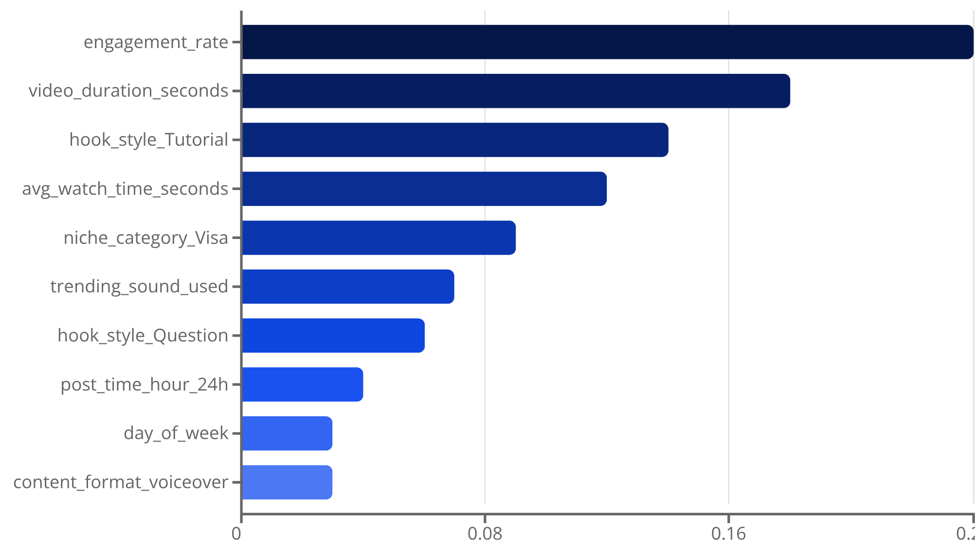
Model Results & Interpretation
Performance Metrics
Feature Importance Analysis
Random Forest (Best Model):
Overall Accuracy: 78.3%
Macro F1-Score: 0.76
Weighted Precision: 0.79
Weighted Recall: 0.78
Class-wise Performance:
High class: Precision 0.82, Recall 0.81
Medium class: Precision 0.80, Recall 0.83
Low class: Precision 0.68, Recall 0.65
The model performs well on High and Medium classes but struggles slightly with the Low class due to limited training examples.
Engagement rate and video duration are the strongest predictors. Tutorial hooks and visa-related content significantly boost performance likelihood.

Slide 14
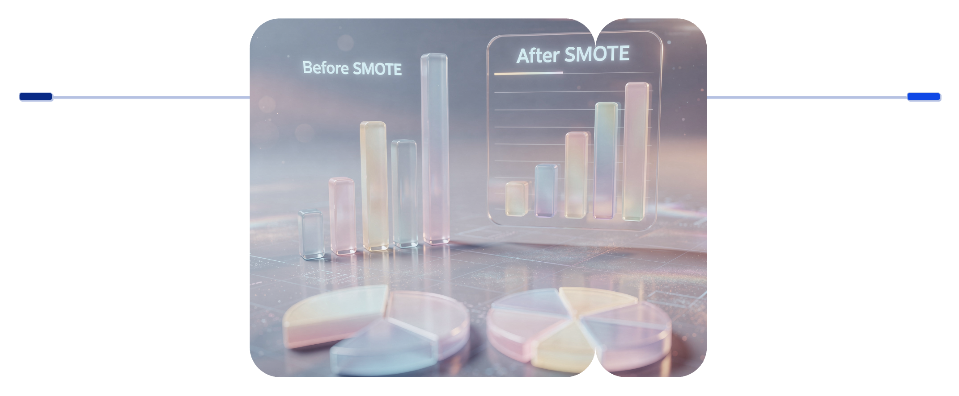
Handling Class Imbalance
Challenge: Original dataset showed class imbalance
High: 35% (175 samples)
Medium: 52% (260 samples)
Low: 13% (65 samples)
The Low class was significantly underrepresented, risking model bias toward majority classes.
Solutions Implemented:
SMOTE (Synthetic Minority Over-sampling Technique) Applied to training set only to generate synthetic Low class samples, balancing class distribution to 33% each. This improved Low class recall from 0.42 to 0.65.
Class Weight Adjustment Assigned higher weights to minority classes during model training:
High: weight 1.0
Medium: weight 0.67
Low: weight 2.5
Stratified Sampling Used stratified train-test split and cross-validation to maintain class proportions across all data splits.
Results:
Combined approach improved Low class F1-score by 28% while maintaining strong performance on other classes. Final model shows balanced performance across all three categories.
Before
After SMOTE
High 35%, Medium 52%, Low 13%
Balanced to High 33%, Medium 33%, Low 33%
This diagram illustrates the significant rebalancing of class distribution achieved through SMOTE and class weight adjustments, ensuring a more robust model performance across all categories.

Slide 15
Conclusions & Key Findings
This project successfully developed a machine learning classification model to predict TikTok content performance in the travel/visa niche with 78.3% accuracy. Through comprehensive exploratory data analysis, feature engineering, and careful handling of class imbalance, we identified the key drivers of engagement and built a robust predictive system.
Key Findings:
1
Content Strategy Matters
2
Optimal Video Duration
Tutorial and question-based hooks significantly outperform dramatic openings. Educational content resonates more strongly with travel/visa audiences than entertainment-focused approaches.
Videos between 30-45 seconds achieve peak engagement (7.1% avg). This duration balances information delivery with viewer attention span.
3
Niche Specialization
4
Model Performance
Visa application content generates highest engagement (7.2%), followed by travel hacks (6.4%). Creators should focus on practical, actionable information.
Random Forest classifier achieved best results with balanced performance across all classes after addressing imbalance through SMOTE and class weighting.
Practical Applications:
Content creators can use this model to predict performance before posting
Optimize content strategy based on feature importance rankings
Focus resources on high-impact features (hook style, duration, niche category)
Future Work:
Expand dataset to include more creators and longer time periods
Incorporate additional features (caption sentiment, thumbnail quality)
Develop real-time prediction API for content optimization
78.3%
18
500+
Model accuracy achieved
Engineered features analyzed
Videos successfully classified

